Slide 1
Azure Networking
David Benedic
Cardinal Solutions Group

Slide 2
Agenda
Virtual Networks
Network Security
Load Balancing

Slide 3
Virtual Networks

Slide 4
Azure Virtual Networks
A protected private virtual network in cloud
Extend enterprise networks into Azure
Cross-premises connectivity

Slide 5
Virtual Network Scenarios
Hybrid Public/Private Cloud
Enterprise app in Microsoft Azure requiring connectivity to on-premise resources
Enterprise Identity and Access Control
Manage identity and access control with on-premises resources (on-premises Active Directory)
Monitoring and Management
Remote monitoring and trouble-shooting of resources running in Azure
Advanced Connectivity Requirements
Cloud deployments requiring IP addresses and direct connectivity across services
Microsoft Azure

Slide 6






Cross-premises Connectivity
Site-to-site
Create a secure connection between your on-premises site and your virtual network
Point-to-site
Create a secure connection via VPN to your virtual network
ExpressRouteTM
Create a private connection between Azure data centers and infrastructures on your premises or in a co-location environment.
Connect at an ExpressRoute location (Exchange Provider facility)
Direct connect via a Network Service Provider
Microsoft Azure

Slide 7
Vnet-to-Vnet Peering
Easily connect virtual networks in the same region
Peer multiple virtual networks, even across subscriptions
No bandwidth throttling (connects through Azure backbone)
Microsoft Azure

Slide 8
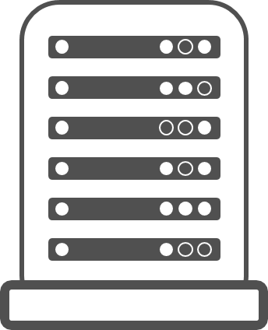
Co-Existence – Gateway-to-Gateway
Gateway
Gateway
VNET in ARM
VNET in ASM

Slide 9
Co-Existence – Gateway-to-Gateway
Gateway
Gateway
VNET in ARM
VNET in ASM
VPN
VPN
NDA Confidential - Royal Philips Electronics

Slide 10
Co-Existence – ExpressRoute to ExpressRoute
Gateway
Gateway
VNET in ARM
VNET in ASM
ASM ER Circuit
ARM ER Circuit
NDA Confidential - Royal Philips Electronics

Slide 11
Co-Existence – Single ExpressRoute Circuit
Gateway
Gateway
VNET in ARM
VNET in ASM
ER Circuit
NDA Confidential - Royal Philips Electronics

Slide 12
Co-Existence – VNET Peering in Region
US West
VNET in ARM
VNET in ASM
Notes:
NOTE: MUST BE IN the same REGION

Slide 13
Co-Existence – VNET Peering
US West
VPN
VNET in ARM
VNET in ASM
NDA Confidential - Royal Philips Electronics

Slide 14
Co-Existence – VNET Peering
US West
ExpressRoute
VNET in ARM
VNET in ASM
NDA Confidential - Royal Philips Electronics

Slide 15
Demo: Create a Virtual Network
Notes:
Demo: VM Extension
Prerequisites:
Azure PowerShell v0.8 or higher has been installed and configured.
Desired Azure subscription has already been selected.
A storage account has been provisioned under the same Azure subscription.
A scripts container has been created under the storage account with public read access.
A helloworld.ps1 PowerShell script has been uploaded to the container. The content of the script is a single line: write-output “Hello World!”
PowerShell environment has been set with large font for easy reading.
A Windows Server 2012 VM has been provisioned.
Steps:
In Azure PowerShell, issue command: Get-AzureVMAvailableExtension | Format-Table -Property ExtensionName, Publisher
The above cmdlet lists existing extensions. Next we’ll see how we can inject an extension to a running VM instance. In the last demo you’ve seen that you can achieve this using Azure Management Portal. Here we’ll do it using PowerShell. In this case, we’ll install Custom Script Extension to an existing Windows Server 2012 VM.
Issue the following cmdlets to get a reference to the virtual machine instance:
$serviceName = “[cloud service that hosts the VM]”
$vmName = “[name of the VM]”
$vm = Get-AzureVM –ServiceName $serviceName –Name $vmName
Next, issue command Get-AzureVMExtension –VM $vm. This lists VM extensions that are currently installed on the VM.
Use the following cmdlet to enable Custom Script Extension, and instruct it to download and execute the helloworld.ps1 (this takes about 20-30 seconds):
Set-AzureVMCustomScriptExtension -ContainerName scripts -StorageAccountName '[your storage account name]' -VM $vm -FileName ‘helloworld.ps1' -Run ‘helloworld.ps1' | Update-AzureVM -Verbose
6. Next, we’ll retrieve and display the script execution result:
$status = Get-AzureVM -ServiceName $serviceName -Name $vmName
$result = $status.ResourceExtensionStatusList.ExtensionSettingStatus.SubStatusList | Select Name, @{"Label"="Message";Expression = {$_.FormattedMessage.Message }}
$result |fl
(see screenshots in hidden slides for references)
(see this blog: http://azure.microsoft.com/blog/2014/07/15/automating-sql-server-vm-configuration-using-custom-script-extension/ for more details on Custom Script Extension)

Slide 16
Network Security

Slide 17
Virtual Network Security
Private virtual network in the cloud
Public IPs expose resources to internet
Network Security Groups restrict access
Security Center alerts and recommendations

Slide 18
Public IP Addresses
Attach to resources
VM
Load Balancer
VPN Gateway
Static or Dynamic (Instance IP)

Slide 19
Network Security Groups
Rule-based network security
Inbound/Outbound
Attached to subnet or VM (nic)
Default set of rules included

Slide 20
Demo: Create a Network Security Group
Notes:
Demo: VM Extension
Prerequisites:
Azure PowerShell v0.8 or higher has been installed and configured.
Desired Azure subscription has already been selected.
A storage account has been provisioned under the same Azure subscription.
A scripts container has been created under the storage account with public read access.
A helloworld.ps1 PowerShell script has been uploaded to the container. The content of the script is a single line: write-output “Hello World!”
PowerShell environment has been set with large font for easy reading.
A Windows Server 2012 VM has been provisioned.
Steps:
In Azure PowerShell, issue command: Get-AzureVMAvailableExtension | Format-Table -Property ExtensionName, Publisher
The above cmdlet lists existing extensions. Next we’ll see how we can inject an extension to a running VM instance. In the last demo you’ve seen that you can achieve this using Azure Management Portal. Here we’ll do it using PowerShell. In this case, we’ll install Custom Script Extension to an existing Windows Server 2012 VM.
Issue the following cmdlets to get a reference to the virtual machine instance:
$serviceName = “[cloud service that hosts the VM]”
$vmName = “[name of the VM]”
$vm = Get-AzureVM –ServiceName $serviceName –Name $vmName
Next, issue command Get-AzureVMExtension –VM $vm. This lists VM extensions that are currently installed on the VM.
Use the following cmdlet to enable Custom Script Extension, and instruct it to download and execute the helloworld.ps1 (this takes about 20-30 seconds):
Set-AzureVMCustomScriptExtension -ContainerName scripts -StorageAccountName '[your storage account name]' -VM $vm -FileName ‘helloworld.ps1' -Run ‘helloworld.ps1' | Update-AzureVM -Verbose
6. Next, we’ll retrieve and display the script execution result:
$status = Get-AzureVM -ServiceName $serviceName -Name $vmName
$result = $status.ResourceExtensionStatusList.ExtensionSettingStatus.SubStatusList | Select Name, @{"Label"="Message";Expression = {$_.FormattedMessage.Message }}
$result |fl
(see screenshots in hidden slides for references)
(see this blog: http://azure.microsoft.com/blog/2014/07/15/automating-sql-server-vm-configuration-using-custom-script-extension/ for more details on Custom Script Extension)

Slide 21
Load Balancing

Slide 22
Load balancing
Load balancing
Multiple VMs share the workload via public facing endpoints
Internal Load balancing
Load balancing between VMs that don’t have public facing endpoints
Microsoft Azure
Internet
Public VIP
Customer vNet
External Load Balancer
Internal Load Balancer
Microsoft Azure
Back end
Front end

Slide 23
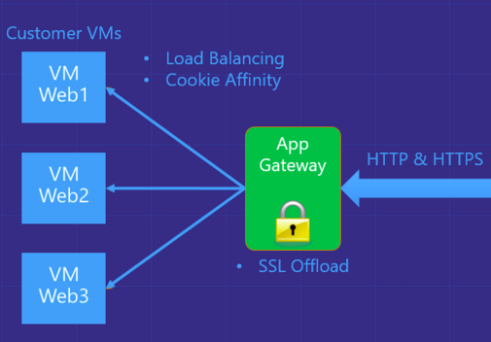
Azure Application Gateway
Azure-managed, layer 7 load balacner
HTTP routing based on app-level policies
Cookies affinity
URL hash
SSL termination and caching
Microsoft Azure

Slide 24
Traffic Manager
Load balancing
Priority Routing
Performance Routing
US West
North Europe
Microsoft Azure
North America
Europe

Slide 25
Azure Networking

